Slide 1
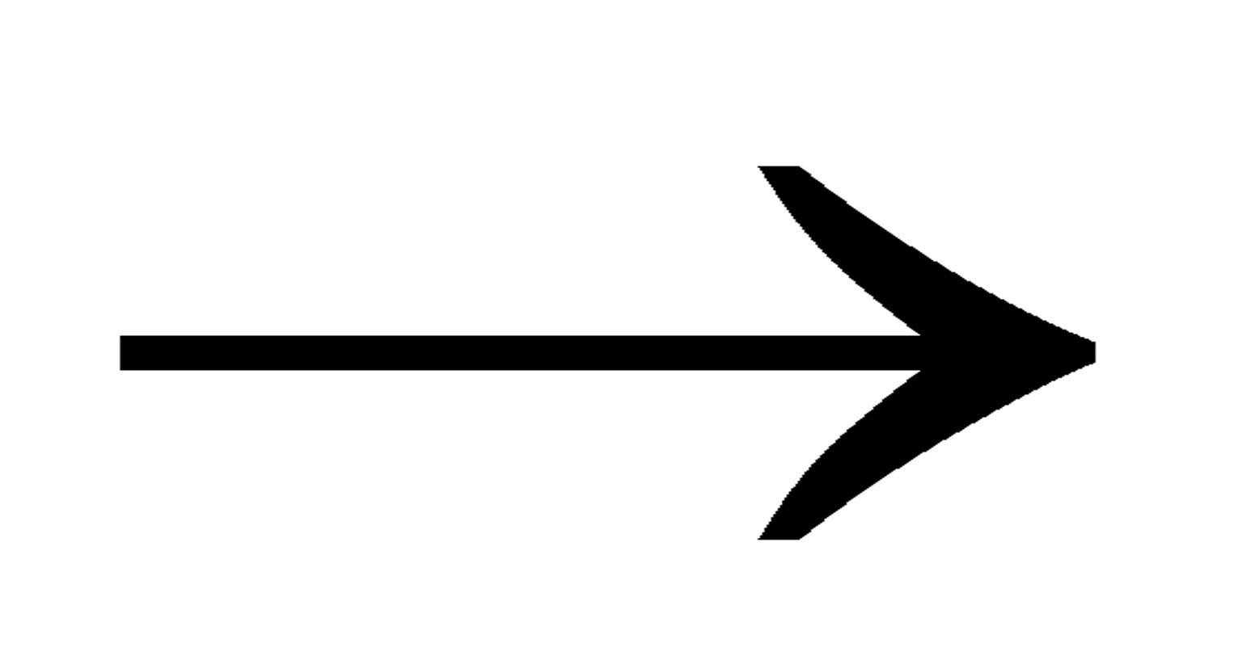
MyFrame
Driver
+ static void main
+ MyFrame
- createLabels
- createTxtBoxes
- createImage
- createButtons
+ addWidget

